Slide 1
IBRD CREDIT SCORECARD PREDICTIVE ENGINE
Hardefa Rogonondo
- Introduction to Machine Learning -

Slide 2
OUTLINE
01
02
03
DATASET & FEATURES
METHODOLOGY
EXPERIMENTATION
Let’s take a closer look at our dataset and find insights!
Time to let Logistic Regression to play with our project
What could possibly go wrong with the model?

Slide 3
HELLO
Name : Hardefa Rogonondo
Occupation : Data Scientist
GitHub : hardefarogonondo
LinkedIn : Hardefa Rogonondo

Slide 4
DATASET & FEATURES
01
Let’s see the sneak peek of our dataset and make features out of it

Slide 5
UNDERSTANDING SCORECARD
WHAT IS A SCORECARD?
WHY USE A SCORECARD?
Scorecards are decision-making tools used in various industries, including finance. They help to evaluate and compare different aspects based on certain predefined metrics.
Scorecards provide a standardized way to assess risk. They convert complex data into a simple score, aiding in making informed decisions.

Slide 6
OUR DATASET
DATASET DATE
SOURCE
DATASET SHAPE
COLUMN TYPES
Last Updated:
June 21, 2023
World Bank Open Data
9012 Rows
33 Columns
Most of it are administrative date of the loans

Slide 7
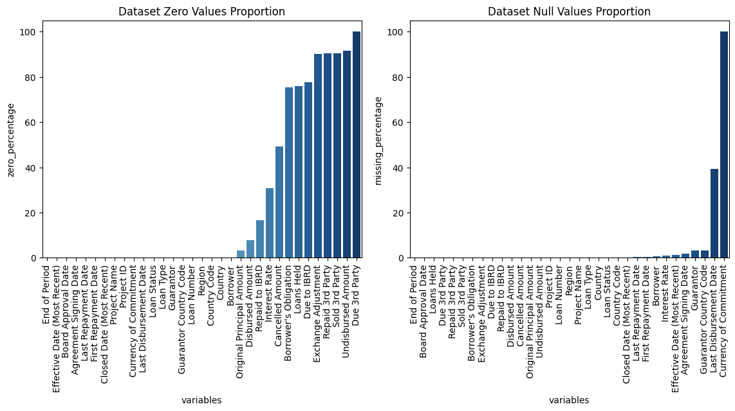
DATA PREPARATION
We clean the data by dealing with missing values appropriately. In our case, any column with more than 50% missing values is dropped, as they aren't adding much information for our journey.

Slide 8
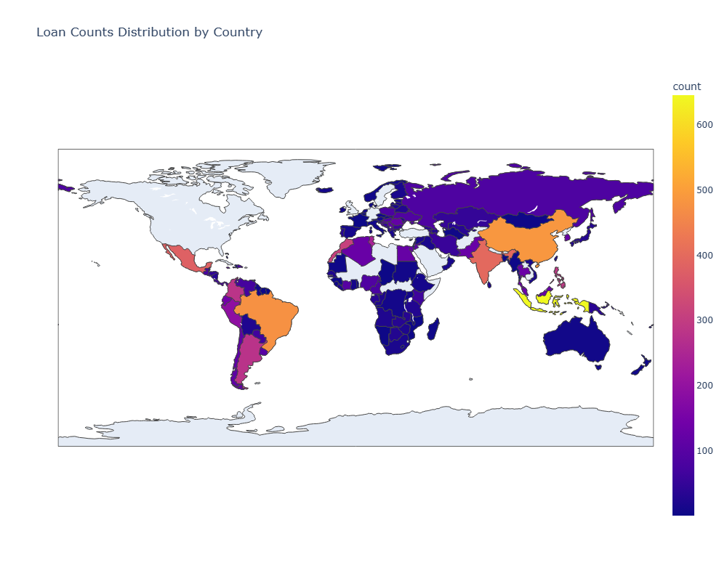
EXPLORATORY DATA ANALYSIS
Explore the global distribution of loans using this world map. Each country is colored according to the number of loans it has received. This broad view helps us understand the geographical spread of our data.

Slide 9
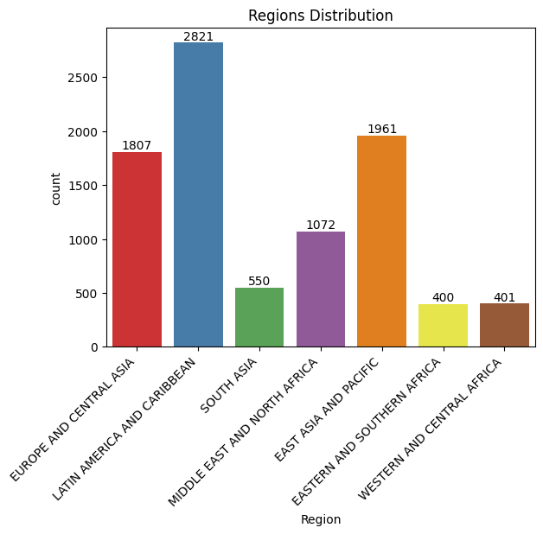
EXPLORATORY DATA ANALYSIS
Let's take a closer look at the loan distribution within different regions. Some regions might have more loans than others, and this could be significant in our journey.

Slide 10
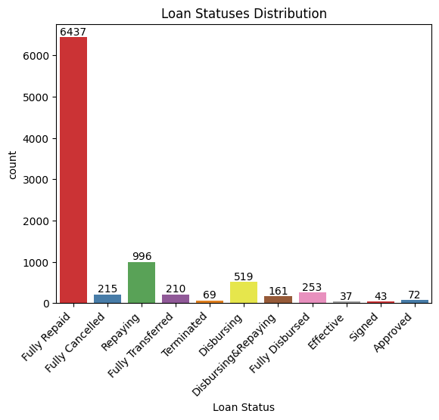
EXPLORATORY DATA ANALYSIS
Now, let's take a look at the distribution of loan statuses. Each status provides us with different insights into the repayment of the loan, giving us clues about 'good' and 'bad' loans.

Slide 11
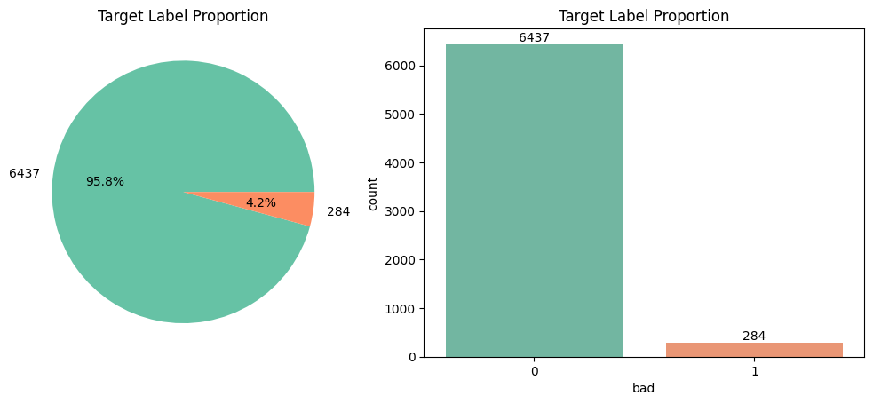
EXPLORATORY DATA ANALYSIS
From the loan statuses, we create labels for our loans. Loans that are 'Fully Cancelled' or 'Terminated' are labeled as 'bad', and 'Fully Repaid' loans are labeled as 'good'. This labeling will guide our model in its predictions.

Slide 12
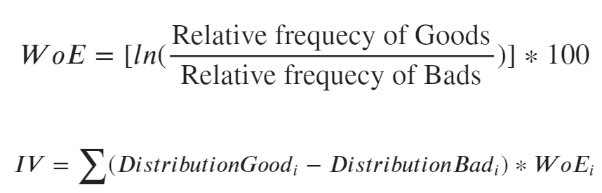
FEATURES ENGINEERING
WEIGHT OF EVIDENCE
INFORMATION VALUE
WoE helps us understand the predictive power of each category within a feature. It's like a compass guiding us to valuable categories.
IV quantifies the amount of information each feature brings to the model.

Slide 13
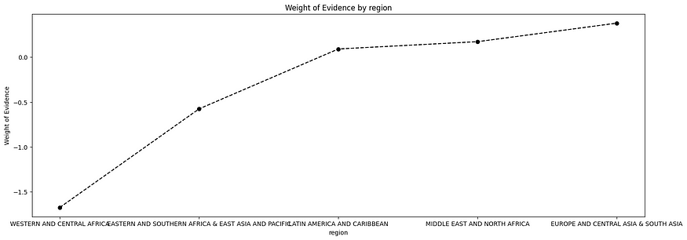
FEATURES ENGINEERING
Let's take a look at an example graph demonstrating the WoE and IV of our features. Understanding these values helps us fine-tune our model and predict more accurately by binning the features into categories.

Slide 14
METHODOLOGY
02
How our Logistic Regression works with our project?

Slide 15
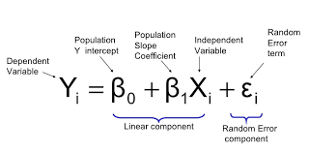
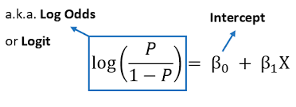
Logistic Regression
'Yi' is our predicted outcome
'B0' is the Y-intercept (our starting point)
'B1' is the slope (the direction and steepness of our model)
'Xi' is our feature
'ei' is the random error term

Slide 16
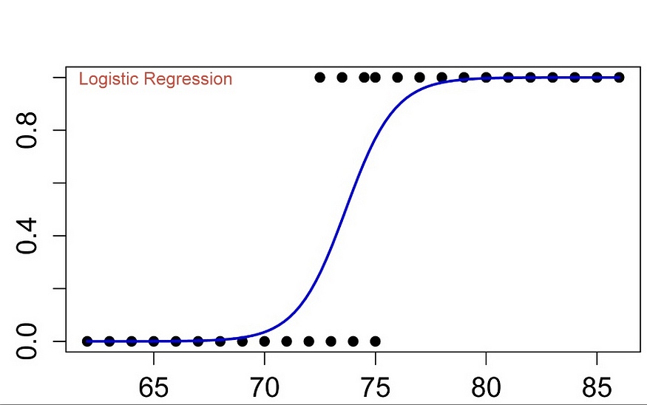
Sigmoid Function
As you can see, the sigmoid function creates an S-shaped curve. On this curve, you can see dots at 0 and 1, representing ‘bad’ and ‘good’ loans respectively.
With the sigmoid function, our Logistic Regression model is fully equipped to predict whether a loan is ‘good’ or ‘bad’ based on the probability.

Slide 17
EXPERIMENTATION
03
How our model works so far?

Slide 18
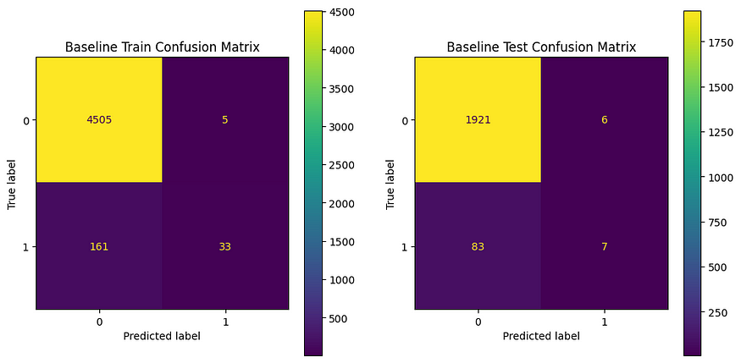
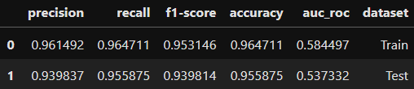
BASELINE MODEL METRICS
Our baseline model provides us with a starting point. Despite its simplicity, it's able to make some correct predictions. However, it struggles to correctly identify 'bad' loans, marking an area for improvement.

Slide 19
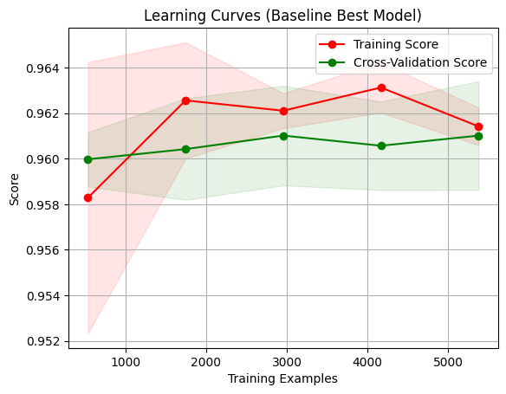
BAYESSIAN SEARCH CROSS VALIDATION
Bayesian Search is a smart strategy we use to select the best settings. The algorithm can learn from past mistakes to make better future decisions.
We use a 5-fold cross-validation as it provides a good balance - not too small to be meaningless, and not too big to be computationally heavy.

Slide 20
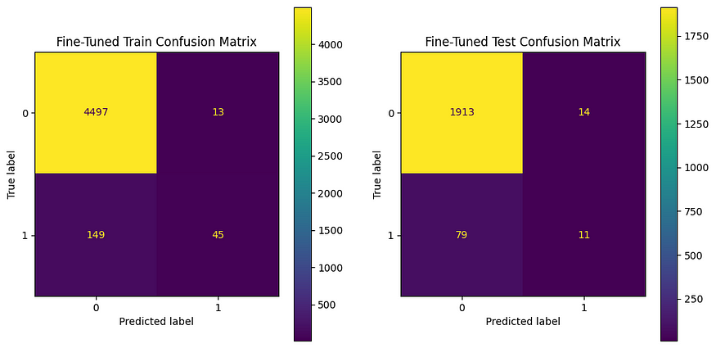
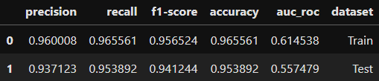
FINE-TUNED MODEL METRICS
The metrics table shows our model's improved performance. Notably, the F1-score, a balance of precision and recall, is slightly better. The AUC ROC, indicating the model's ability to distinguish between classes, has also improved.

Slide 21
RESULTS
CONCLUSIONS
FUTURE WORKS
We predicted loan risks using Logistic Regression.
Our baseline model provided a good starting point, but still overfitting.
With Bayesian Search cross-validation, we improved its ability to identify 'bad' loans.
Although the accuracy of our fine-tuned model is slightly less, it excelled in distinguishing between 'good' and 'bad' loans, an important factor for our problem.
Gather more data for a more balanced dataset.
Experiment with other feature engineering techniques and models.
Leverage advanced techniques like ensemble learning or deep learning for better predictions.
Develop the model further for real-time prediction through an API.

Slide 22
THANK YOU

